Slide 1
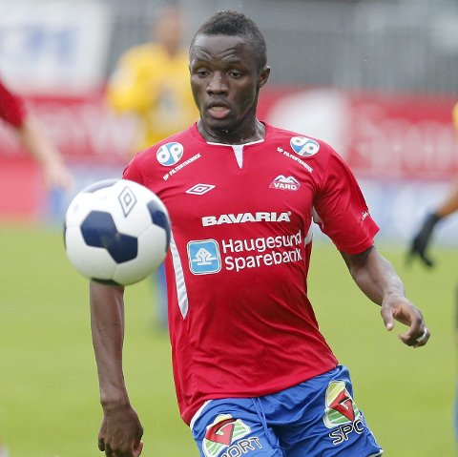
Bubacarr Sumareh
Both-footed centre-forward with accurate shots and excellent physics including body balance and decent acceleration skill. Experienced player who also can bring the ball into final third on his own.
position: centre-forward
citizenship: Gambia
date of birth: 14.03.1991
height/weight: 180 cm/ 80 kg
transfermarkt profile

Slide 2
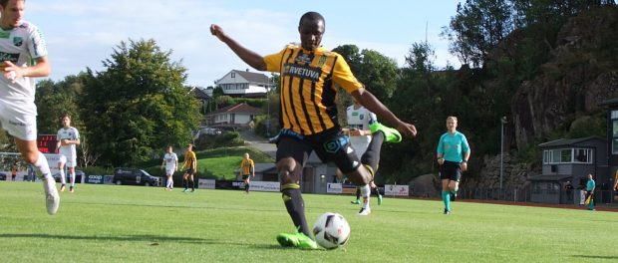
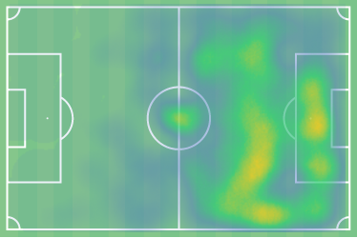
position
Plays as a centre-forward. Tries to shoot from both feet from inside the penalty box. Can also go deeper to get the ball or to help his teammates in pressing.
Установка от главного тренера «Шахтера» - Паулу Фонсека

Slide 3
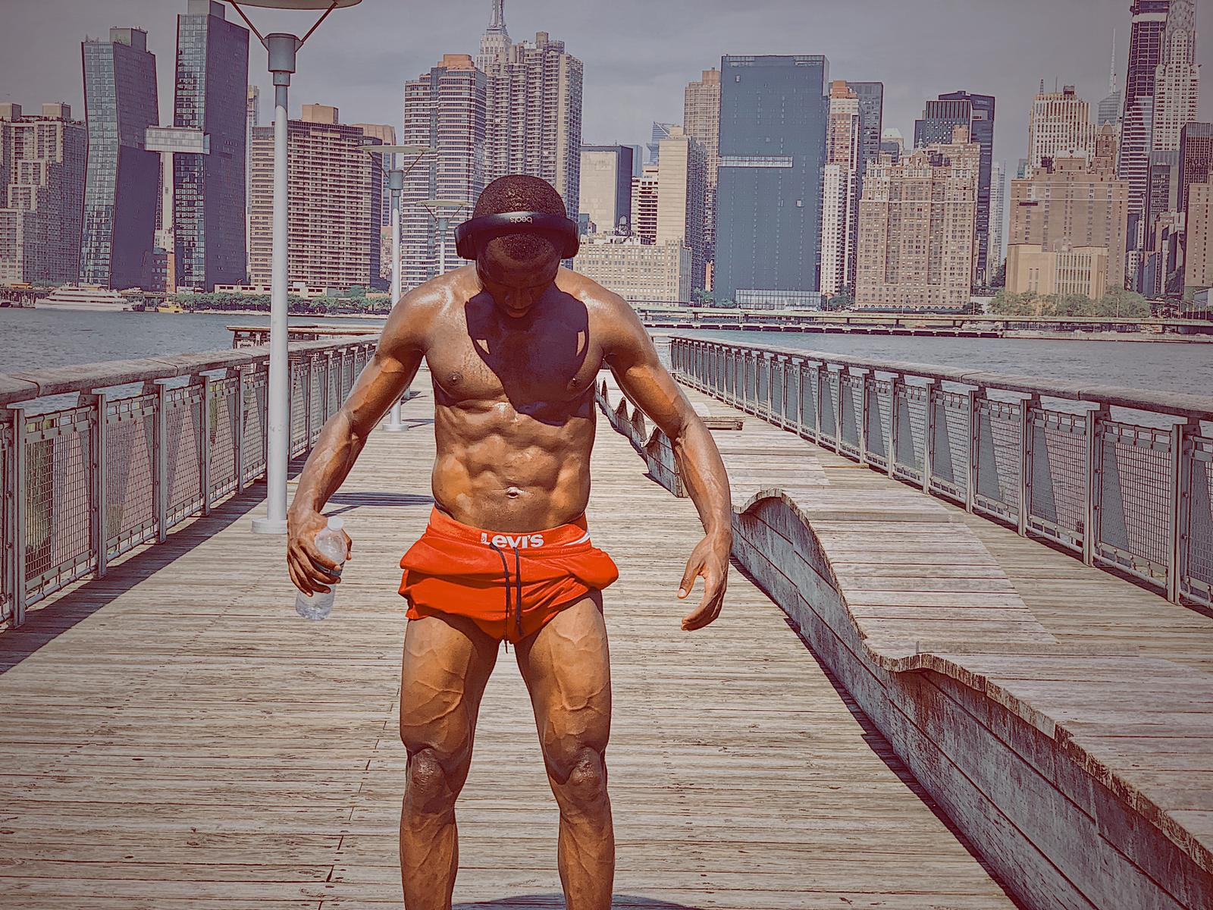
Career description
Sumareh has started his career in Gambia before coming to Norway in January 2013. There he has played for FC Kopervik and FC Vard before being signed up by FC Egersund in 2017. There he has made 77 appearances and scored total of 49 goals and became one of team leaders.

Slide 4
stats & numbers
All stats as per 90 minutes.
9 air challenges (20% success). Also 3 defensive challenges (53% success) and 19 attacking challenges (32% success).
77% pass accuracy with 16 passes in total. 1 key pass per 90 min with 67% of accuracy.
2.7 dribbles (65% success) and 1.8 tackles per 90 min (73% success). Commits 2.5 fouls and suffers 1.8 foul per 90 min.
In general, performs above average level of the Norwegian second divison (see next slide).

Slide 5
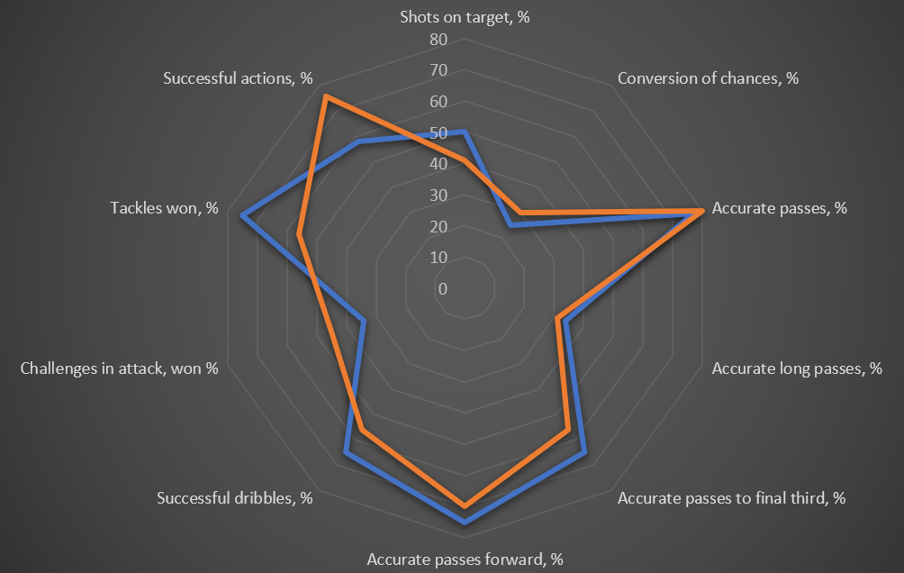
stats & numbers

Slide 6
Goals & assists

Slide 7
tackling
Uses his good physical characteristics to challenge an opponent. Prefers to stay on feet when tackling.

Slide 8
interceptions
Accelerates onto a ball well. Intercepts balls and fights for each free ball.

Slide 9
dribbling
Has good dribbling abilities due to his body balance and acceleration skill. Goes past opponents thanks to quick turns and moving aside.

Slide 10
Shots on goal
Prefers to shoot accurate, sometimes lack power. Is able to finish episode on his own.

Slide 11
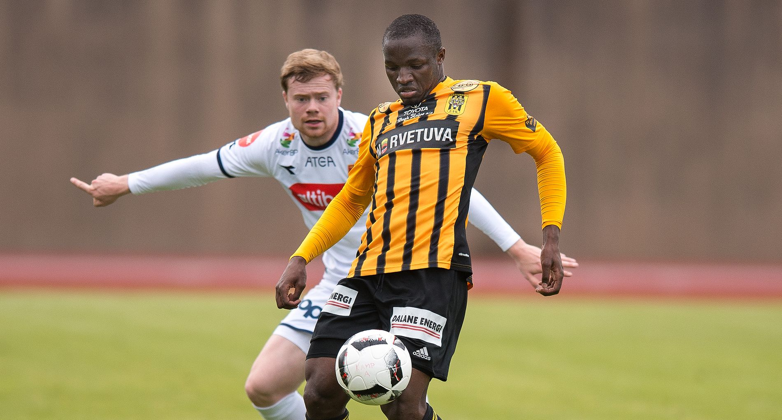
conclusion
Bubacarr Sumareh is a centre-forward which can be very useful in attack in schemes with only or two forwards.
He is a fast player who uses actively his physical data both when tackling and moving forward. Has good acceleration skill which allows him to receive balls and move past an opponent making quick body moves.
He now plays in a league which is slightly under his real level of performance. He will be useful for most of teams in Asia which start attacks with long through balls or play on counter-attacks.

Slide 12
Contact us -
we are ready to cooperate anytime!
“YFT” football agency
Andrey Grushin
director
tel./whatsapp +35794040076
andreygrushin@me.com
yft-agency.com

